Slide 1
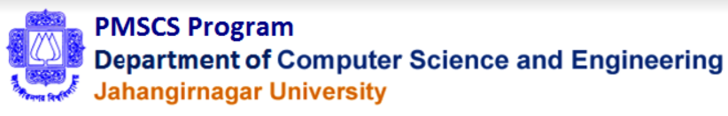
STUDY ON DESIGN AND DEVELOPMENT OF BANGAMATA HALL MANAGEMENT SYSTEM
Presented by Md. Shariful Islam ID: CSE202301044 Batch: 31th Shama Proshad Ghosh ID: CSE202301126 Batch: 31th | Supervised by Prof. Dr. Md Abul Kalam Azad Department of Computer Science & Engineering, Jahangirnagar University
Masters in CS, Intake Spring-2023

Slide 2
Introduction
The University Hall Management Web App is designed and developed to facilitate the overall management of university hall, room allocation, student registration, maintenance tracking. It is intended to develop a user-friendly and scalable web application that meets the unique requirements of university hall management.
This web-based system can keep all residential student records, allocate/de-allocate room seats, can collect establishment charge with proper audit trail. Also, the application has admin control who can add, update staff, give permission, remove permission, deactivate staff, etc. Master data of the system is configurable from UI by the admin.
Student can visit their own information with default password. There is also mechanism for information security and credential management.
The system has been developed using C#, MVC, .NET Core 6, and repository pattern with backend MSSQL Database.

Slide 3
Background and Problem statement
The Bangamata Hall Management System aims to enhance student, teacher and staff experience for hall seat bookings and management. However, several security issues must be addressed to ensure the system's integrity and protect sensitive student data. Potential challenges include vulnerabilities to SQL injection, cross-site scripting (XSS), and insufficient access controls. Without proper measures, attackers could exploit these weaknesses to gain unauthorized access, manipulate data, or disrupt this hall management. Moreover, inadequate encryption and authentication mechanisms may compromise user privacy and authentication security. Therefore, robust security measures must be implemented, including input validation, encryption of sensitive data, strong authentication methods, and access controls. Addressing these security concerns is crucial to safeguarding the Bangamata Hall Management System's functionality, integrity, and the privacy of its users.

Slide 4
Outline(Design & Development)
Introduction
Objectives
Tools And Technology
Working Process Flowchart
Use Case Diagram
Data Flow Diagram
MVC Structure
Model Files
View Files
Controller Files
GUI - Graphical User Interface
User Access Control
Function and Modules
Project Demo screenshot
Results & Report

Slide 5
Outline(Security Related)
User Authentication
Data Encryption
Input Validation
Cross-Site Request Forgery(CSRF) Checking
Session Management
Logging and Monitoring
File Upload Security
SSL Certificates

Slide 6
Objective Of The Project
The main objective of this Implementation of Bangamata Hall Management System project is to design and implement for the easy to maintain, data accuracy, large data control, high availability and ensure security. Here are the features implemented:
Student Info Add/Update,
Allocate/de-allocate seat,
Yearly establishment charge collect from student,
Hall Officials Add/Update,
System User Credentials Management
Master data configure from UI by admin user,
Information Access to Student with default password,
Dynamically menu accessibility by user role,
Password recovery,
Responsive design from mobile view.

Slide 7
Tools And Technology
Programming Languages: C#,
Framework: ASP.NET Core MVC, Repository Pattern,
Scripting Language: HTML5, CSS3, Bootstrap, JavaScript, jQuery,
Database: MSSQL,
Server: IIS,
API: SMS/Email integration,
Tools: MSSQL Server Management Studio, Tortoise git client,
IDE: Visual Studio 2022,
Version Control: github, git.

Slide 8
Working Process Flowchart
Start
Display home page
Already logged in?
Is Staff User?
Display Student Info details
Add/Update Student
Display Staff dashboard
Process Establishment Charge
Allocate/De-allocate seat
Process User Credentials
Configuration/Setting Master data
Add/Update Staff
end

Slide 9
Use case Diagram
9
Student Entry
Student Update
Show Student Details
Staff Entry
Admin
Staff Update
Establishment charge Entry
Establishment Charge Update
Student
User Credential Entry
User Credential deactivate
User Login
Password Reset
Home page
Dashboard

Slide 10
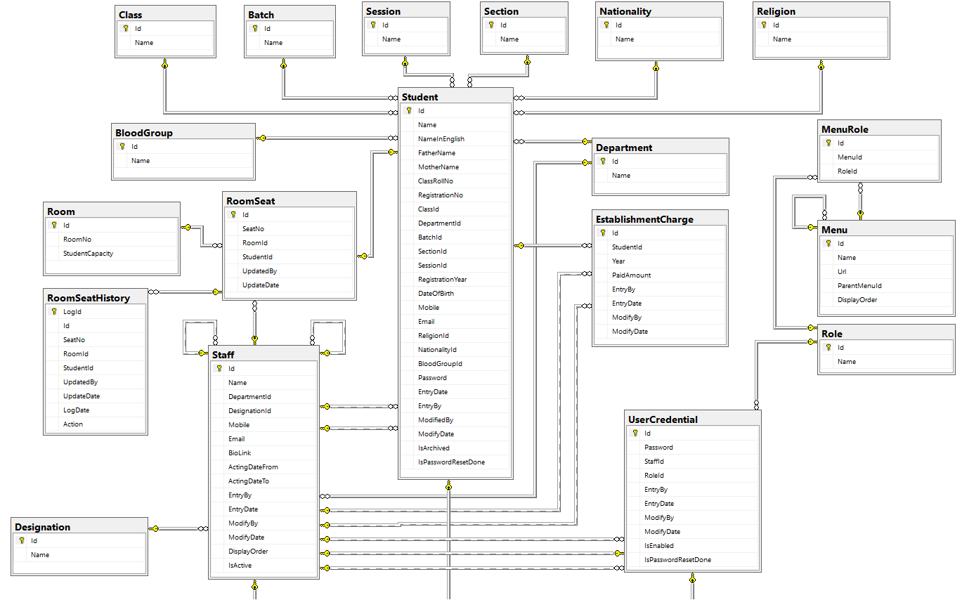
Entity Relationship Diagram
10

Slide 11
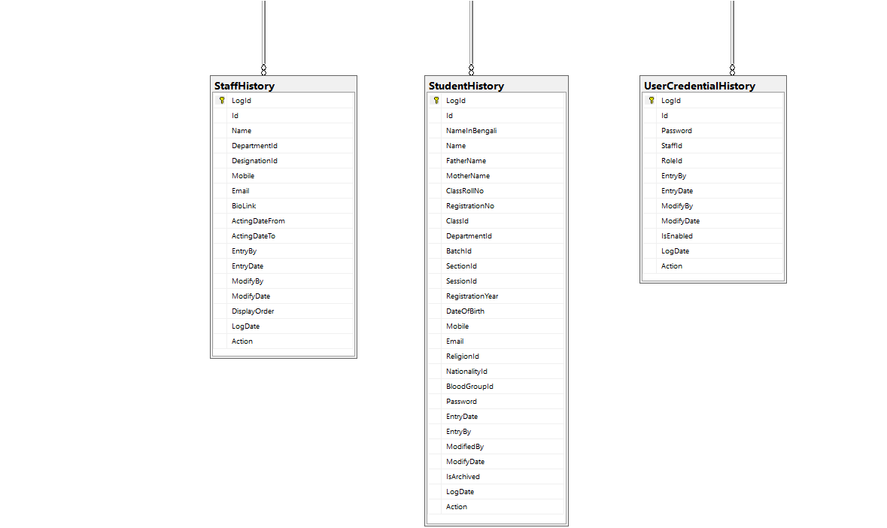
Entity Relationship Diagram(contd.)
11

Slide 12
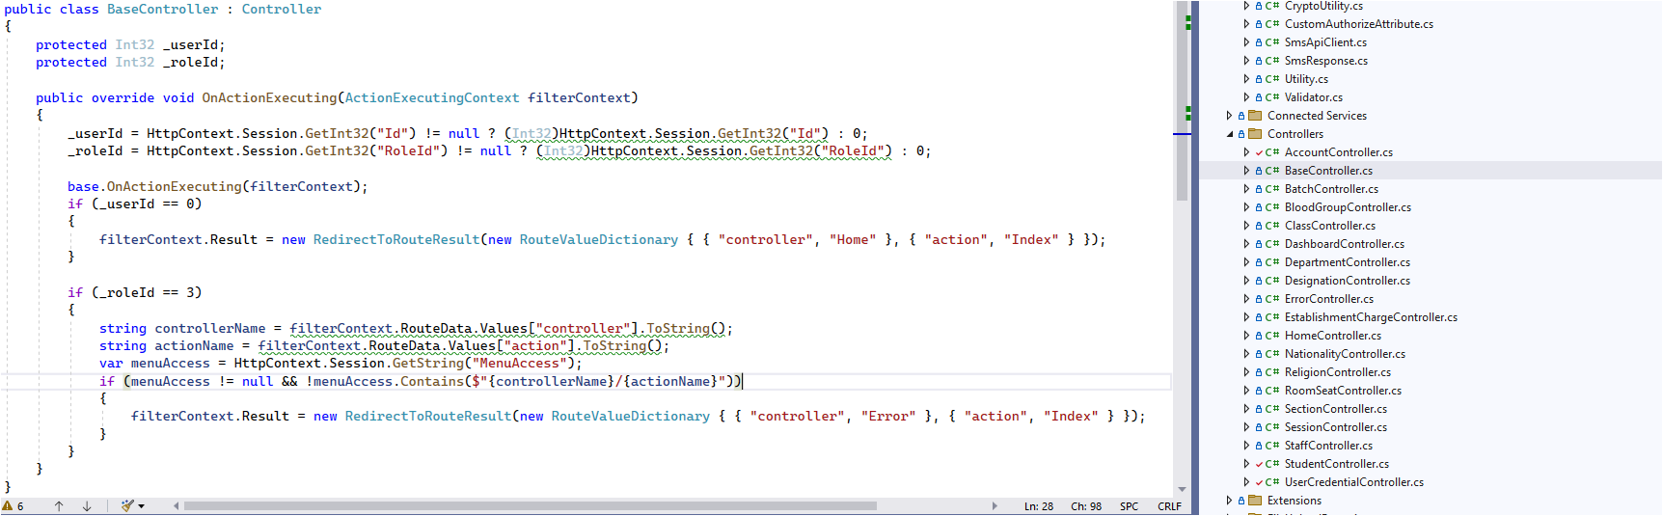
Controller Files
12

Slide 13
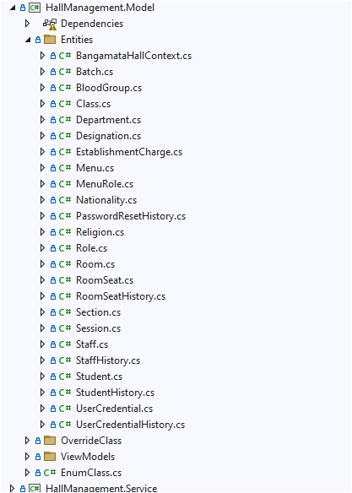
Model File
13
Auto generated model from DB using commands:
1. cd "D:\CFormManagementSystem\CFormManagement.Model"
2. dotnet ef dbcontext scaffold "Server=SHARIF-PC\MSSQLSERVER2019;User Id=bangamatahalldev;Password=bangamatahalldev;Database=BangamataHall;Encrypt=false;TrustServerCertificate=True;Trusted_Connection=True;" Microsoft.EntityFrameworkCore.SqlServer -o Entities -f

Slide 14
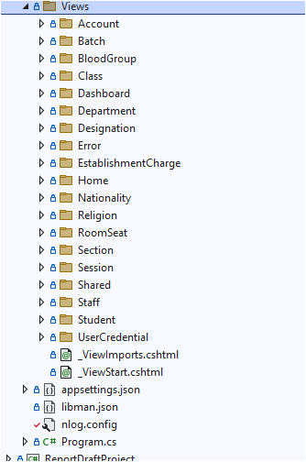
View Files
14

Slide 15
GUI - Graphical User Interface
15
Student Interface
Entry/Update/Details/List
Room Seat Interface
Entry/Update/Details/List
Establishment Charge Interface
Entry/Update/Details/List
Staff Interface
Entry/Update/Details/List
User/Staff Credential Activate/Inactivate Interface
Entry/Update/Details/List
User Dashboard
User Login
Password Reset
Master/Configuration Data Interface
Entry/Update/Details/List

Slide 16
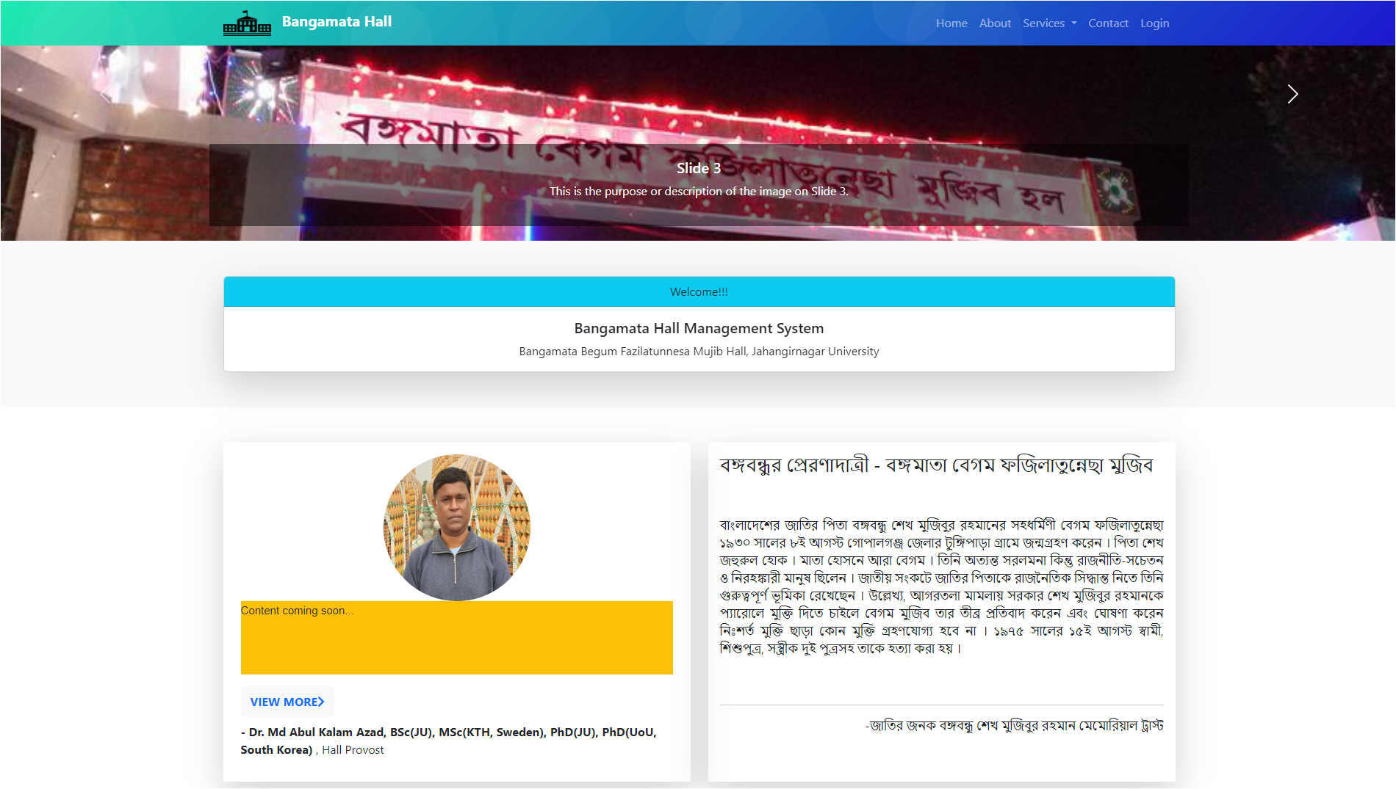
Home page
16
l Any user will be visited at this home page first,
l The user will have different navigation pages and login link,
l Different sections are at this page, e.g., image slider, statement of honorable hall sir provost sir, about Bangamata Begum Fazilatunnes, FAQ, etc.

Slide 17
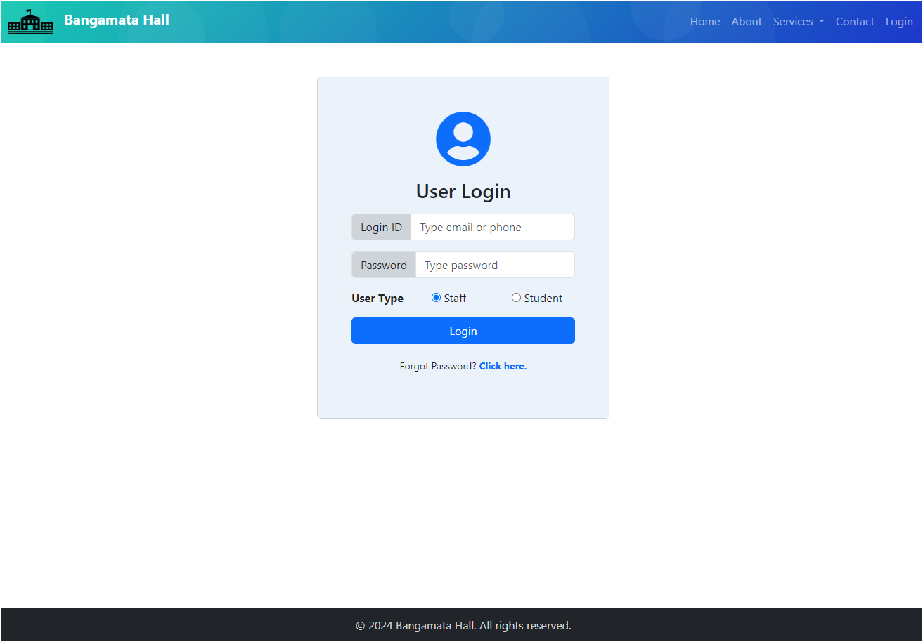
Login Panel
17
Two type of user can be login in the system, 1. Staff, 2. Student,
Staff user can have Admin role or developer role,
Student user can login in the system but don’t have admin privileges.

Slide 18
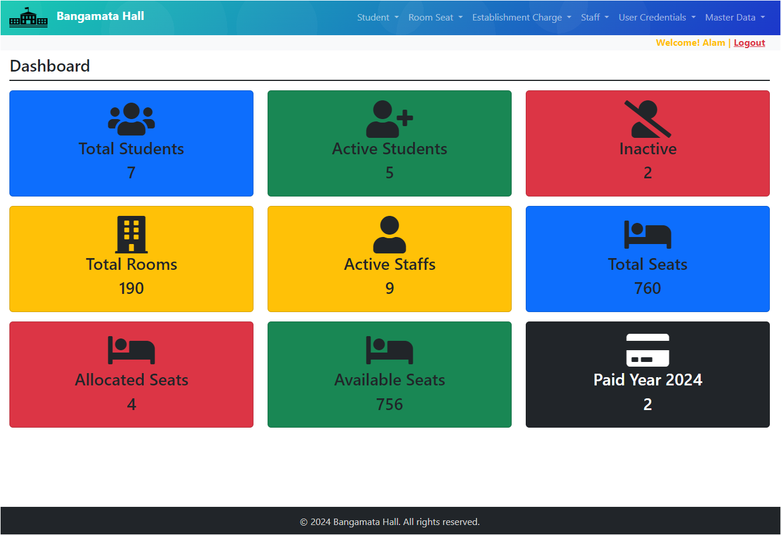
Admin Dashboard
18
Admin user will be seen current data/count in the whole system,
Menu items will be loaded dynamically,
Have right to Student UI, Room Allocation, Staff UI, Establishment charge collect, User credential activation privileges, etc.

Slide 19
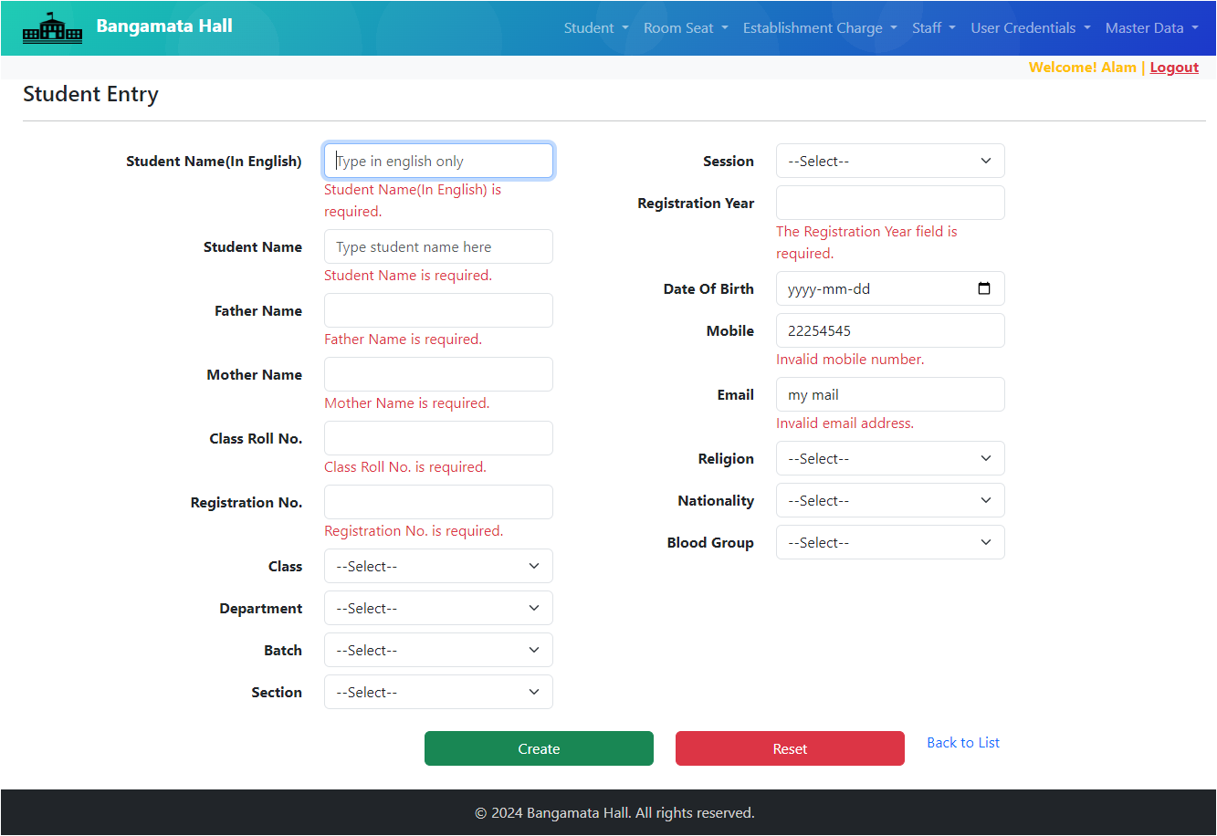
Student Information Entry
19

Slide 20
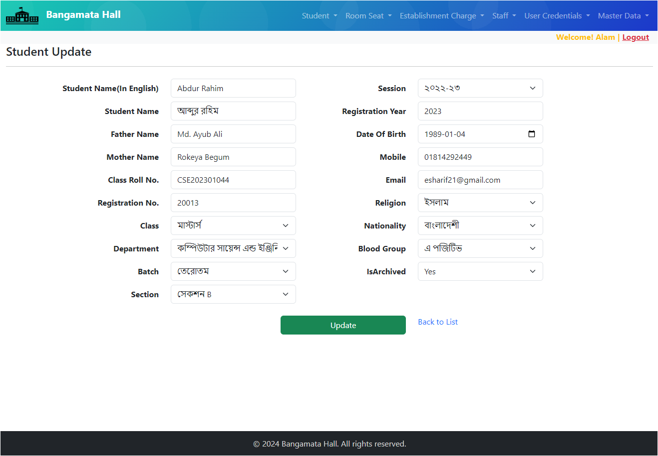
Student Information Update
20

Slide 21
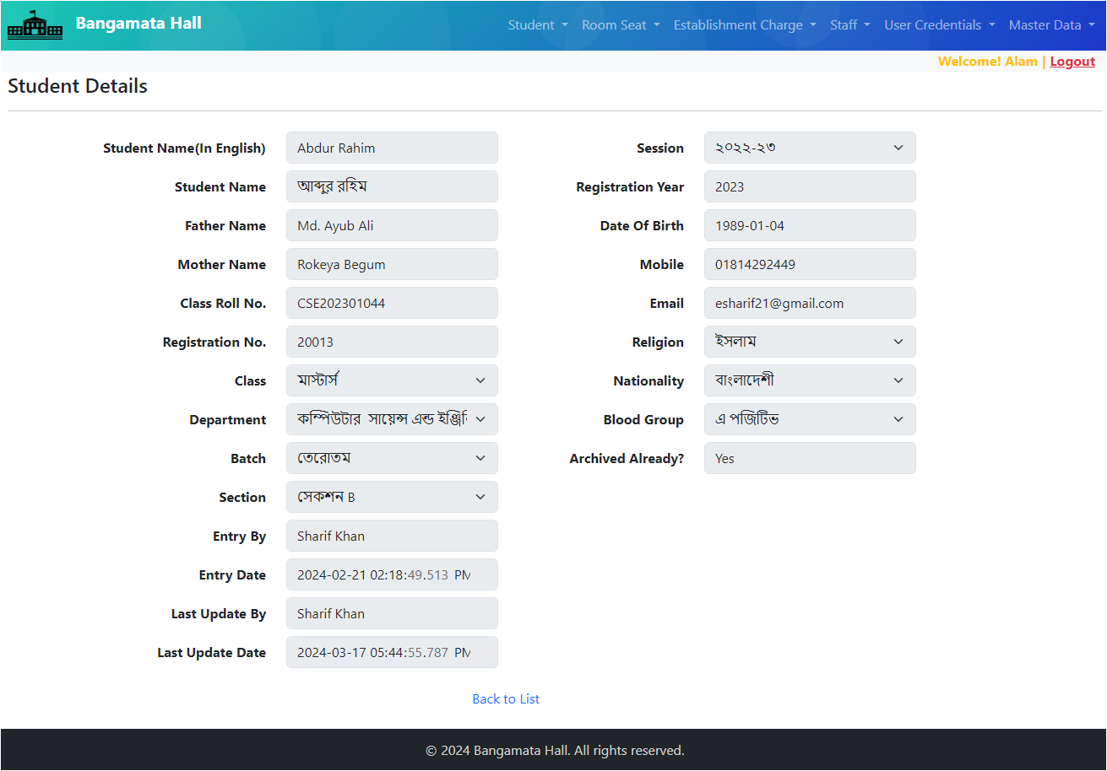
Student Information Details
21

Slide 22
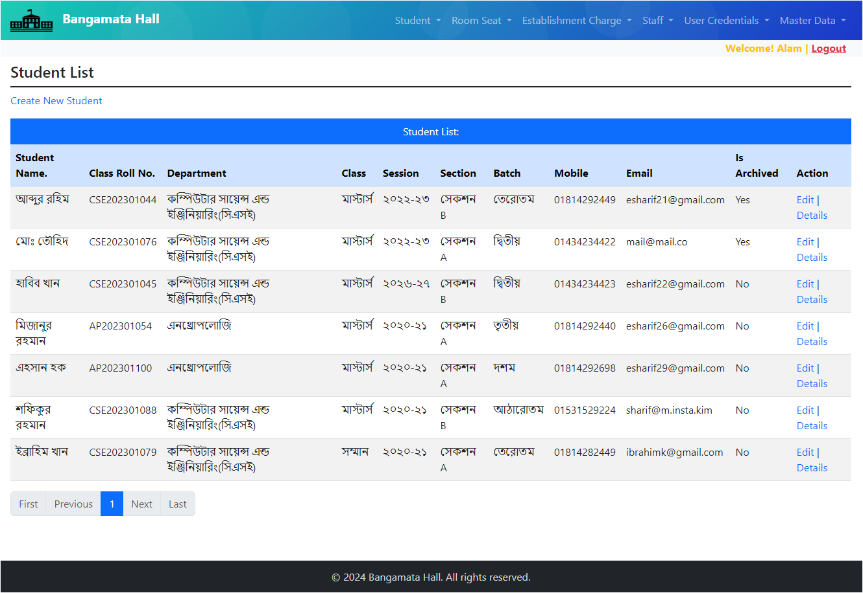
Student List
22

Slide 23
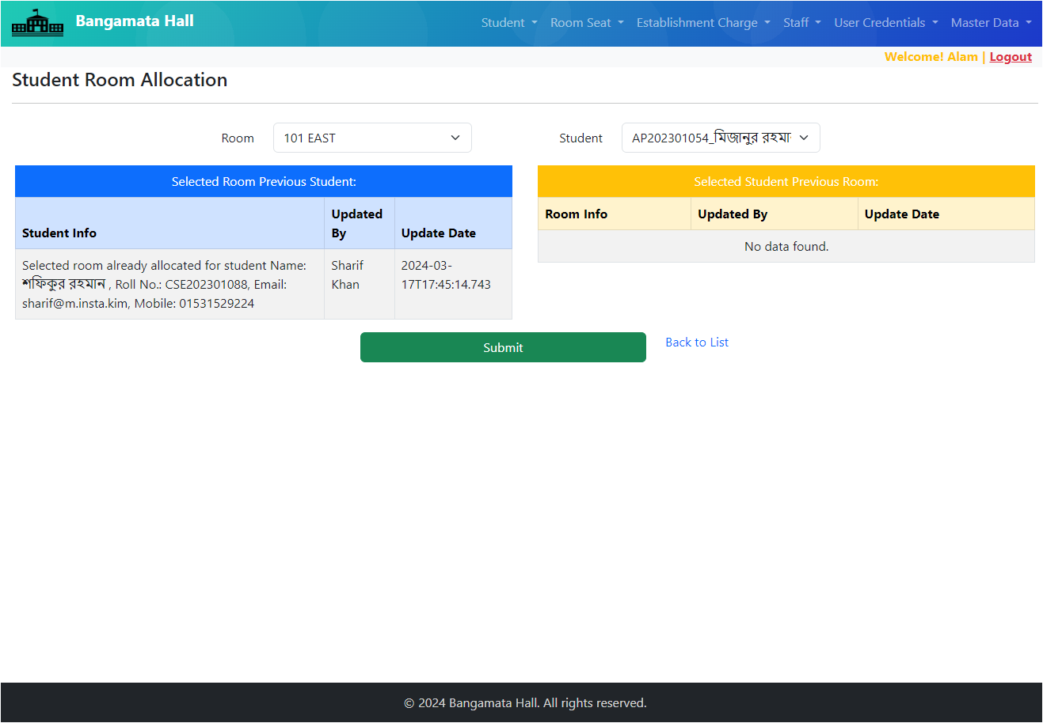
Seat Allocation/De-allocation
23

Slide 24
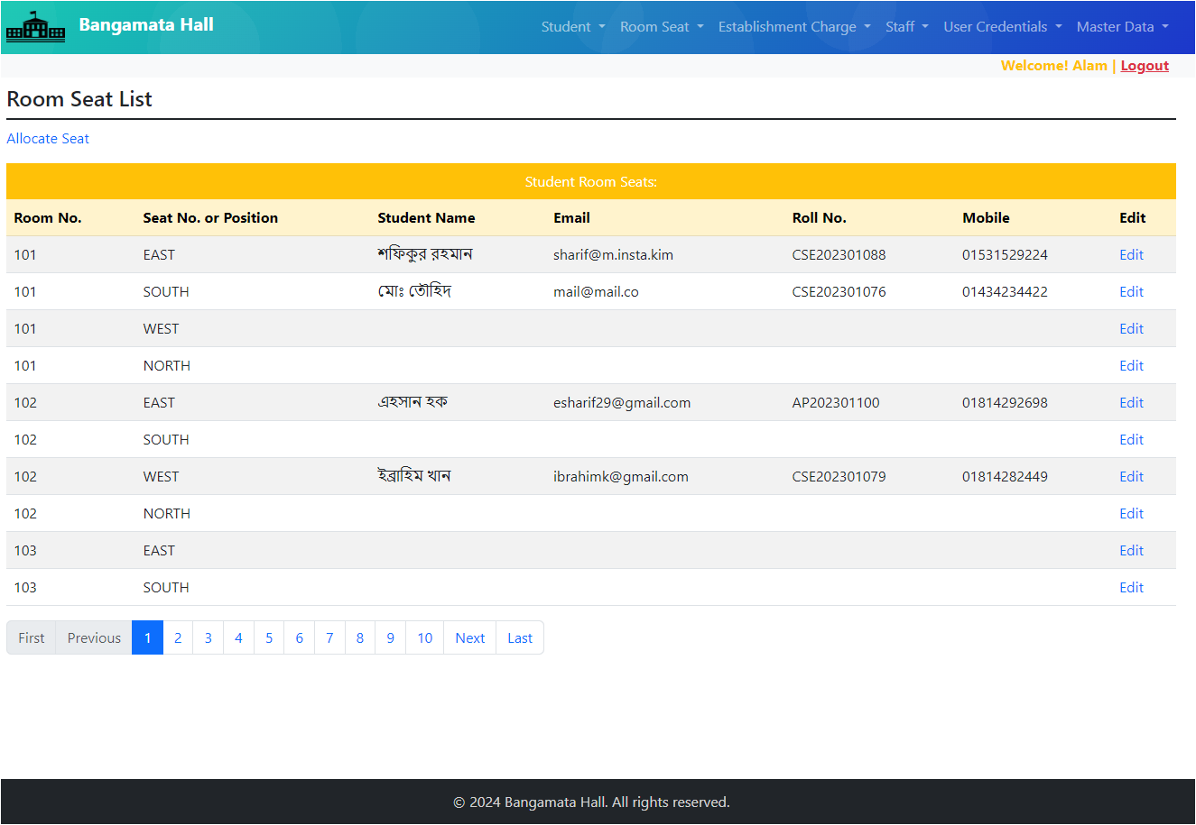
Seat Allocation List
24

Slide 25
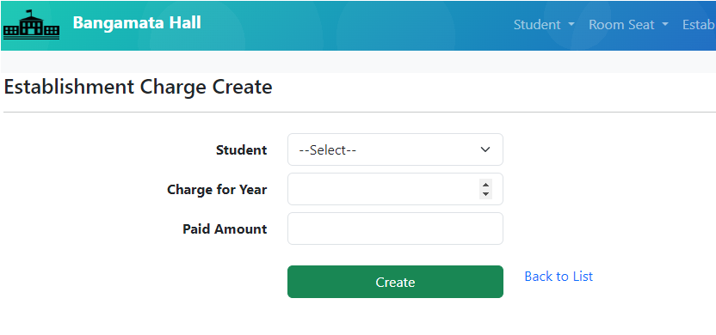
Establishment Charge Entry
25
Establishment charge is collected yearly. So, system block to entry same student payment multiple times in a year.

Slide 26
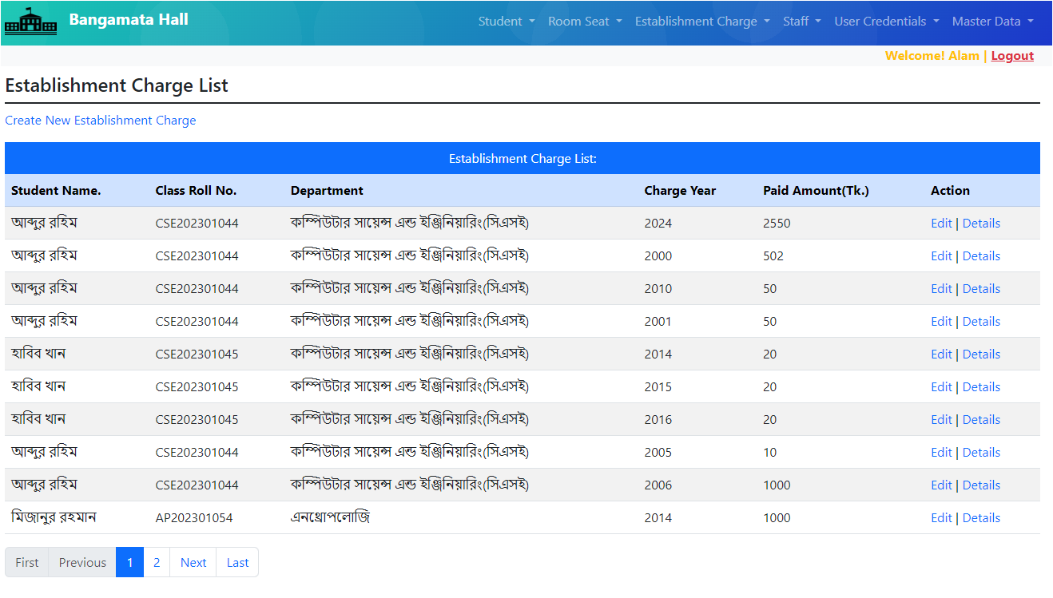
Establishment Charge List
26
Establishment charge can be edit or show details from the grid.

Slide 27
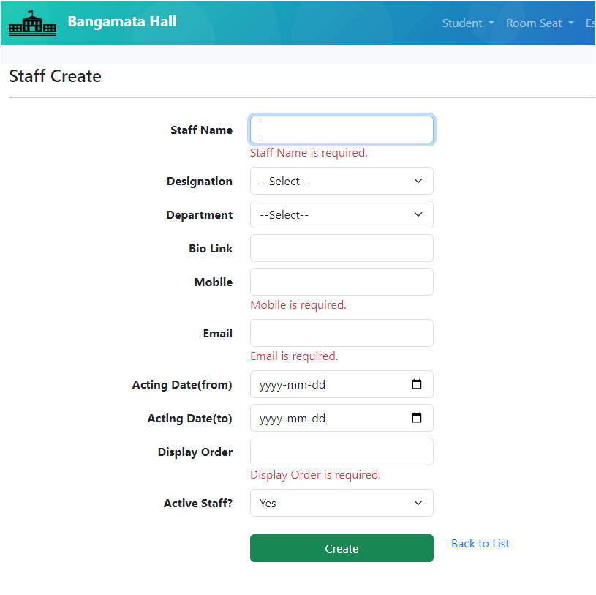
Staff/Officer Entry
27
An Admin user can entry/input other staffs or officers,
Mobile or email cannot be duplicate,
Data is being validated accordingly.

Slide 28
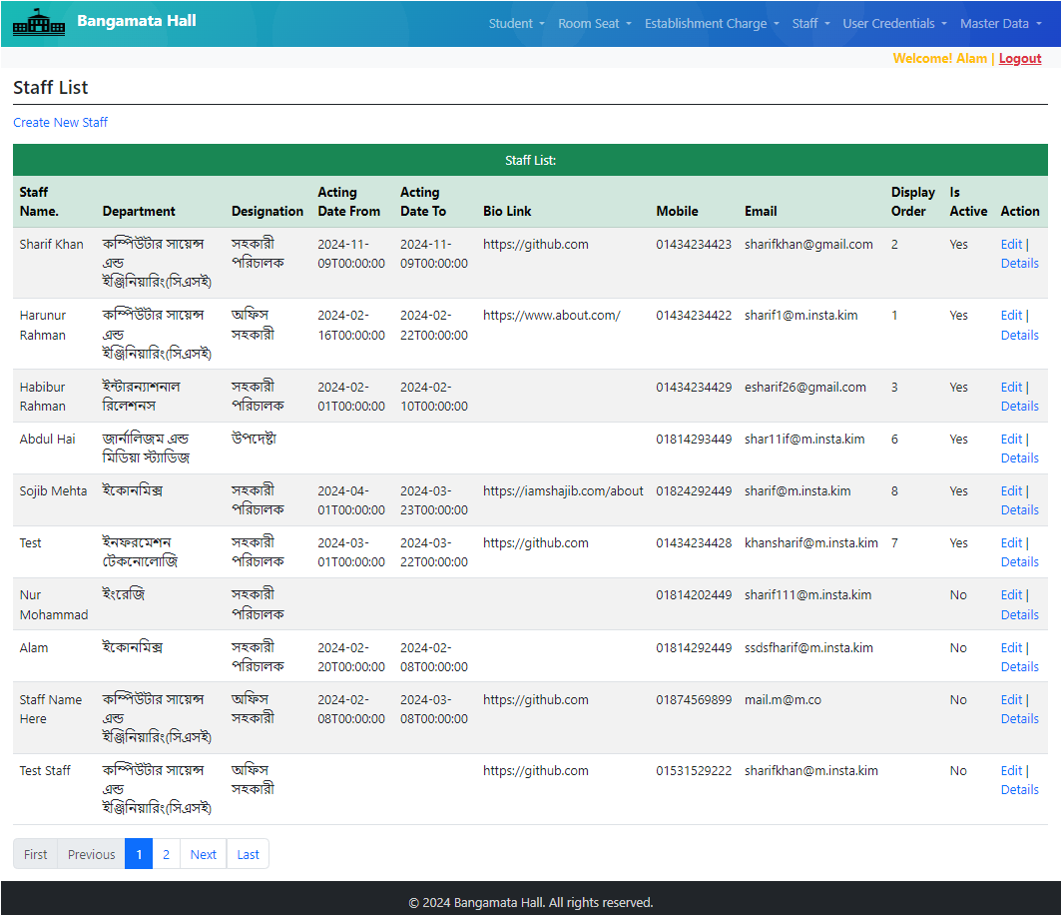
Staffs/Officers List
28

Slide 29
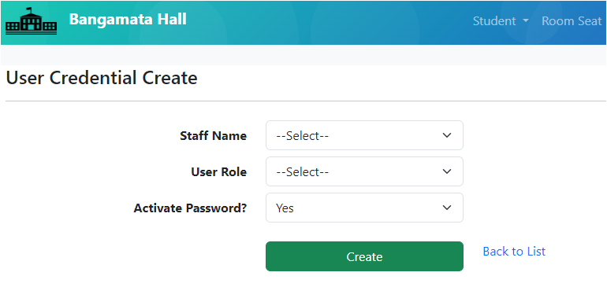
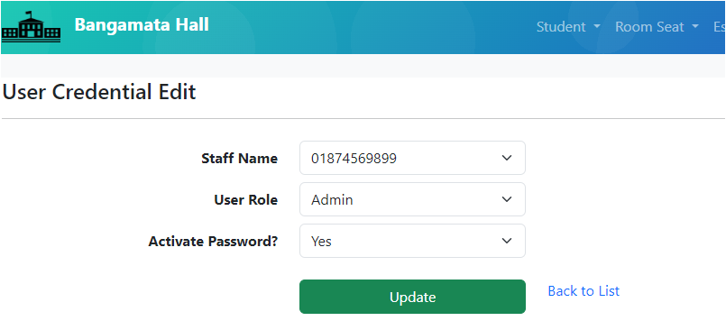
Staff Access Activate/De-activate
29
1. Activate staff access
2. De-activate staff access

Slide 30
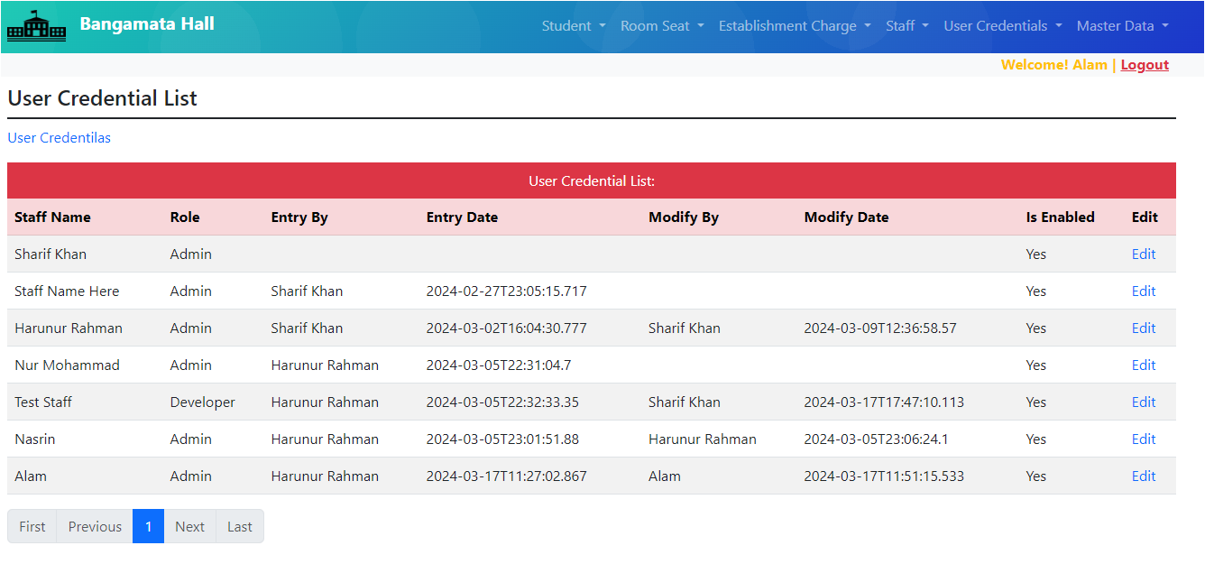
Staff Access List
30

Slide 31
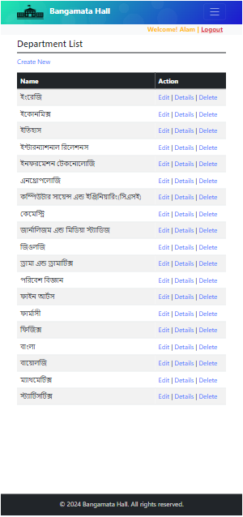
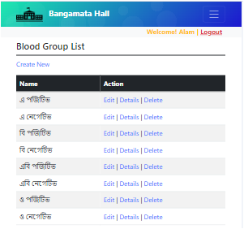
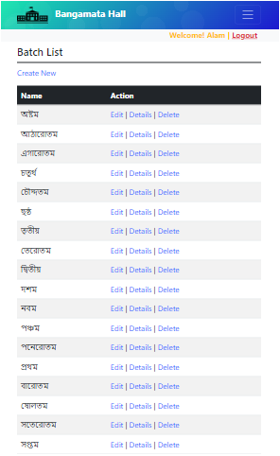
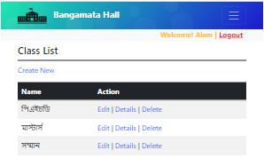
Master Data/Configuration
31

Slide 32
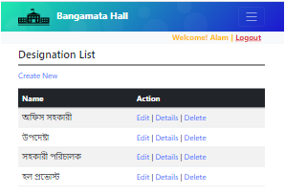
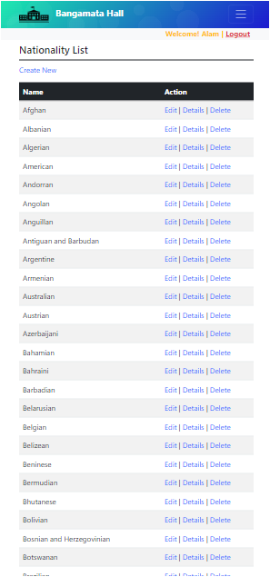
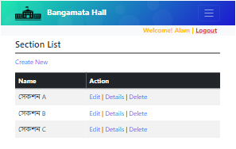
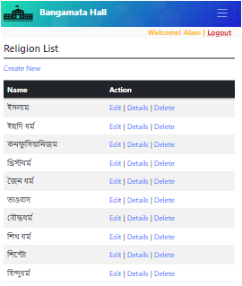
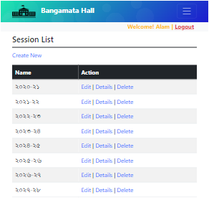
Master Data/Configuration(2)
32

Slide 33
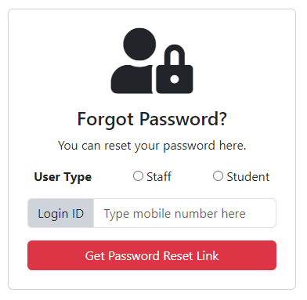
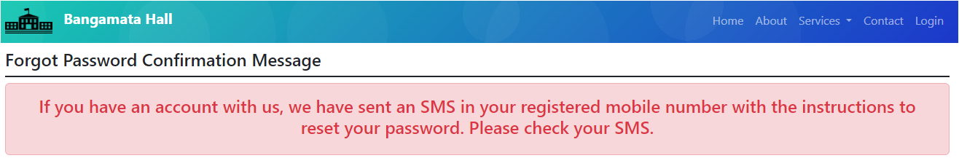
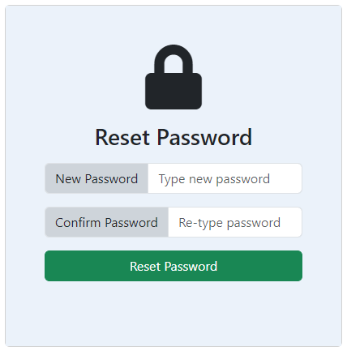
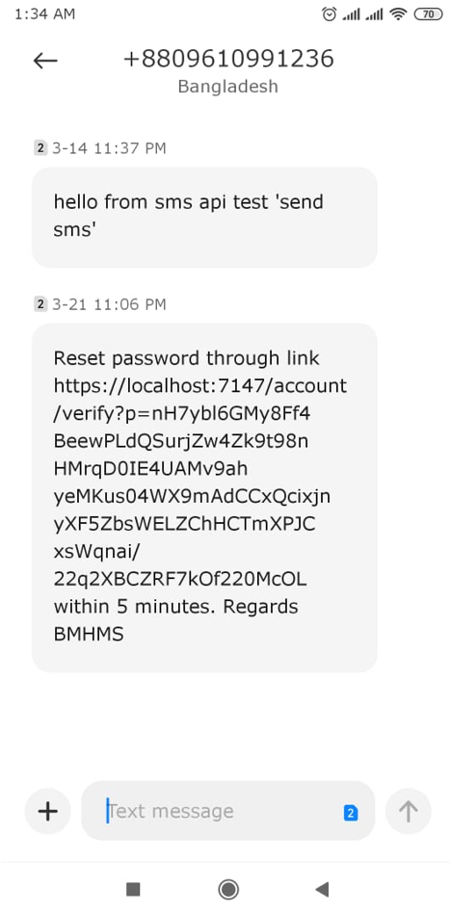

Forget Password Verification link
33

Slide 34
User Authentication
User authentication is a critical aspect of web application security that verifies the identity of users attempting to access a system or platform. It ensures that only authorized individuals or entities are granted access to specific resources or functionalities.
Password-based authentication: Users authenticate themselves by providing a Email/username and password combination. If any of them is wrong then it will show error message.
Secure Password Policies & Use strong passwords: Herer we enforce strong password policies, no plain text password (like for example 123456) to prevent unauthorized access. In this project we use a number / character / uppercase letter / lowercase character for password. And password will be also at least minimum eight(8) characters.

Slide 35
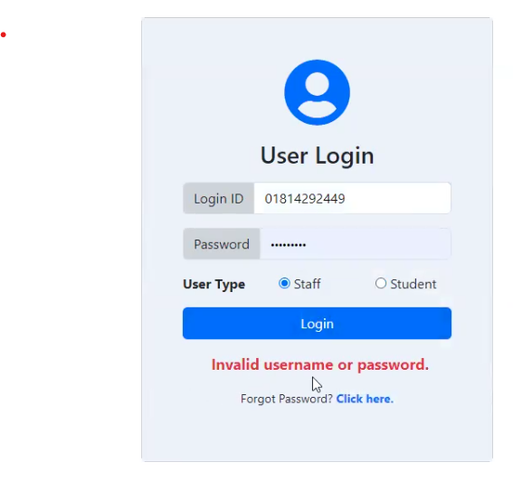
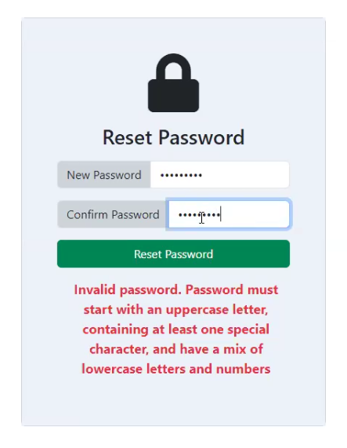
User Authentication

Slide 36
Data Encryption
Data encryption is a fundamental security technique used to protect sensitive information by converting it into a form that cannot be easily understood by unauthorized users.
Encryption Algorithms:
Encryption algorithms are mathematical formulas used to convert plaintext (unencrypted data) into ciphertext (encrypted data).
Hashing algorithms: In this hall management project we didn’t use encryption in the traditional sense, we used to generate fixed-size hashes from input data (e.g. MD5, AES). Our hash functions are typically used for data integrity verification and password hashing.

Slide 37
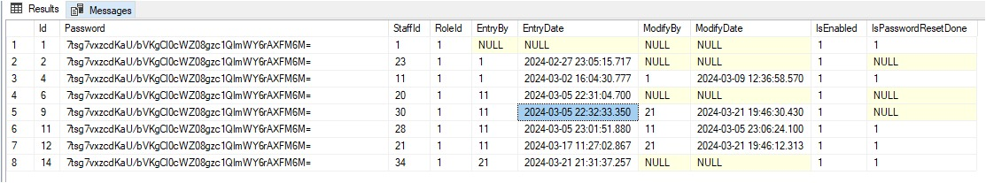
Data Encryption
Bellow this image our password data are encrypted by hash algorithms

Slide 38
Input Validation
Input validation is a crucial security practice in software development that involves inspecting and validating data entered by users or received from external sources before processing or storing it. The goal is to ensure that the data meets specific criteria, such as required field, format, length, type, and range, to prevent various security vulnerabilities and data integrity issues.
Purpose of Input Validation:
Preventing injection attacks: Input validation helps mitigate common injection attacks such as SQL injection, NoSQL injection, and command injection by rejecting malicious input that may contain executable code.
Ensuring data integrity: By enforcing data format and constraints, input validation helps maintain data integrity and consistency within the application's database or data store.
Enhancing usability: Input validation also improves the user experience by providing immediate feedback on invalid input, guiding users to correct errors effectively.

Slide 39
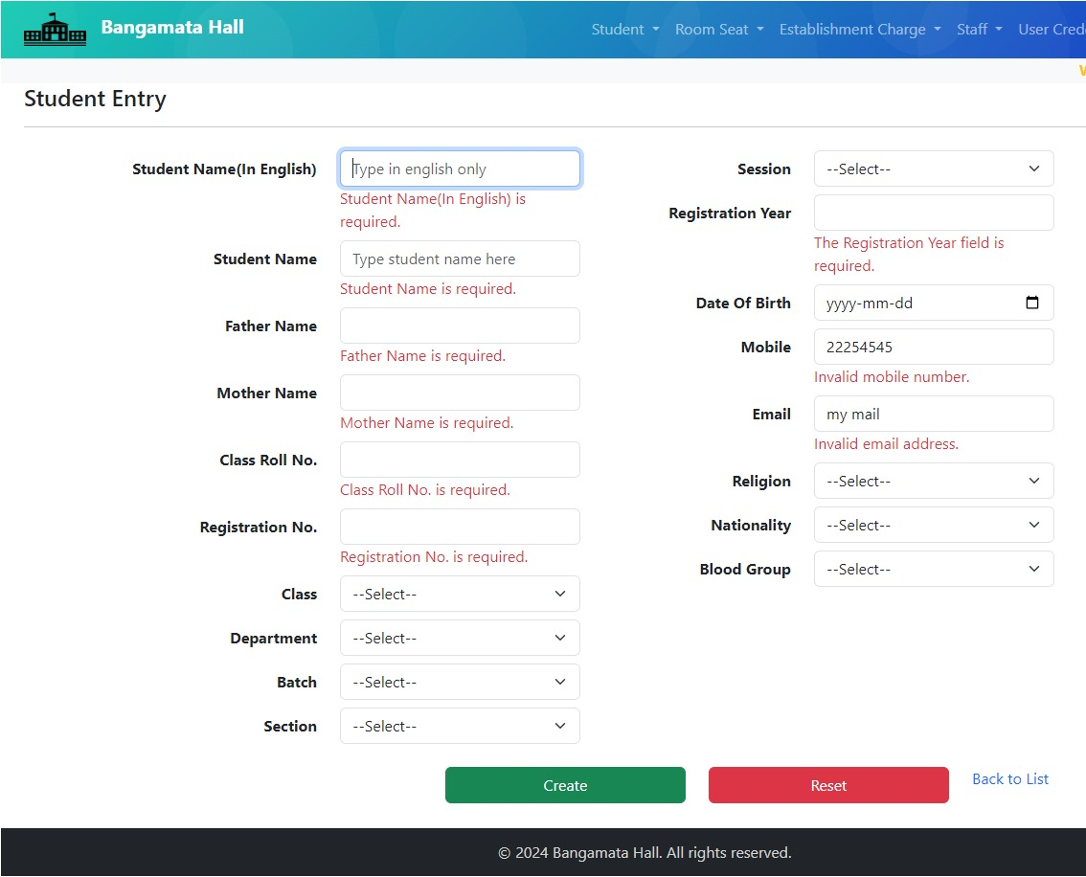
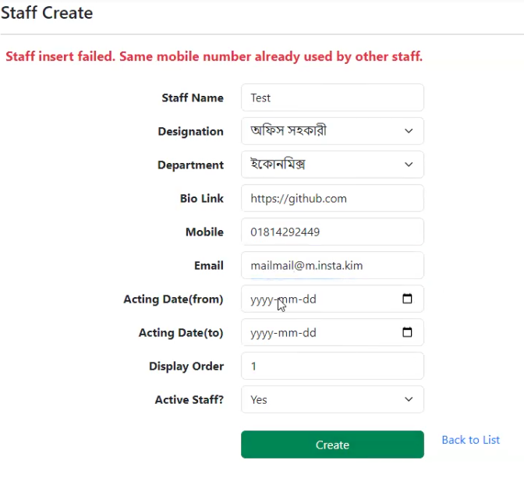
Input Validation
In this Bangamata Hall Management System we ensure input validation all of the form that are collecting and storing data into our database. BANGAMATA HALL MANAGEMENT SYSTEM

Slide 40
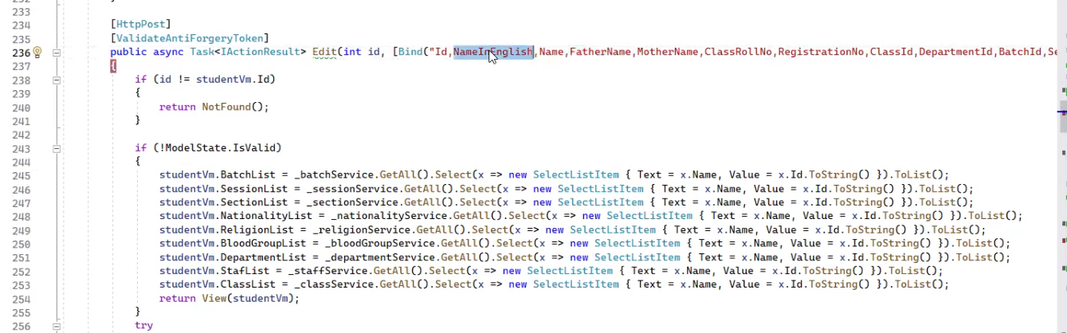
Cross-Site Request Forgery(CSRF) Checking
In this project by Implementing CSRF tokens as hidden fields or headers in forms and requests. These tokens are unique per session and are validated by the server to ensure that the request originated from the legitimate user's session. Here is the code that we are used for preventing CSRF Issue.

Slide 41
Session Management
Session management is a fundamental aspect of web application security that involves the creation, maintenance, and termination of user sessions. Sessions enable a web server to recognize and maintain stateful interactions with clients (e.g., web browsers) across multiple requests and responses.
Session Creation: When a user accesses a web application, the server creates a unique session identifier (session ID) and associates it with the user's session data. Typically, session IDs are stored in cookies or appended to URLs and are used to track and identify the user's session throughout their interaction with the application.
In our project we consider this session management security issue. When a students / users are logout from a browser tab then no work will be do from others tab.

Slide 42
Database Security and Backup
Securely configure the database, use parameterized queries to prevent SQL injection, and implement the principle of least privilege for database access.
Access Control: Implement robust access control mechanisms to restrict access to the database based on user roles and privileges.
Regular Backup Schedule: Here we will establish a regular backup schedule to create copies of the database at predetermined intervals (e.g., daily, weekly). Consider the criticality of the data and the frequency of changes when determining the backup frequency.

Slide 43
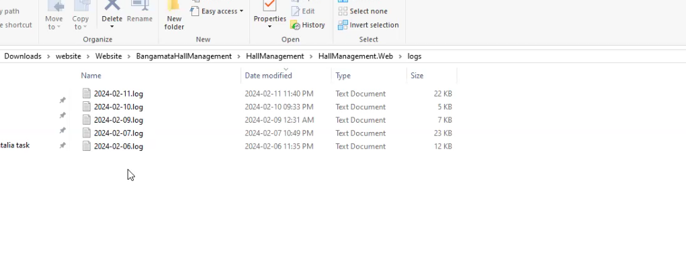
Logging and Monitoring
Logging and monitoring are essential components of an effective cybersecurity strategy, providing visibility into system activities, detecting suspicious behavior, and enabling timely incident response. Here’s we consider of logging and monitoring aspects of our project security
Event Logging: In this project we collect and store logs of various system events, such as user authentication, access control changes, privilege escalations, and system configuration modifications.

Slide 44
File Upload Security
File upload security is crucial for preventing various types of attacks, including malicious file uploads, file tampering, and exploitation of vulnerabilities in web applications.
File Type Validation: Validate file types to ensure that only allowed file formats are accepted for upload. Restrict uploads to specific file types (e.g., images, documents) based on the user requirements.
File Size Limitation: Enforce size limits on uploaded files to prevent denial-of-service (DoS) attacks and resource exhaustion. Specify maximum file sizes based on the users capacity.
We have not done any uploading for this project yet. These security issues will be considered if file uploads are ever performed.

Slide 45
SSL Certificates
SSL (Secure Sockets Layer) certificates are digital certificates that authenticate the identity of a website and encrypt data transmitted between the user's web browser and the web server.
When our project will be in live server then we’ll bought a SSL certificate for our domain to enable encryption of data transmitted between the user's browser and the web server. This encryption helps protect sensitive information, such as login credentials, personal details, and financial data, from interception by unauthorized parties.

Slide 46

FAQ
Any Question?

Slide 47
47
Thank You All

